Slide 1

INTERNATIONAL CONFERENCE ON VLSI AND MICROWAVE AND WIRELESS
TECHNOLOGIES (ICVMWT 2024)
Low-Complexity Convolutional Neural Network for Salt and Pepper Noise Removal in Digital Images
Authors
Prudhvi Raj Budumuru, J. A. Sai Santosh, K. N. V. N. Gupta,
M. Srihari, N. S. S. N. Venkat, K. Yogisuhas Reddy
Vishnu Institute of Technology (Autonomous)
Department of Electronics and Communication Engineering
PRESENTED BY
N. S. S. N. Venkat (20PA1A04B1)
Paper ID: 31

Slide 2
CONTENTS
Abstract
Introduction
Literature Review
Objective
Need for Advanced Denoising Techniques
Proposed Method
Results and Discussion
References

Slide 3
ABSTRACT
Digital images are may get affected by Gaussian noise, Salt and pepper noise, Speckle noise during transmission, capturing and storage.
Salt and pepper noise is one of the major noise types, it degrades the image with black and white spots resulting in the loss of required information.
Hence, restoration of impulse noise free digital image is a challenging task to fulfill the various applications fruitfully in the fields such as medical, security, communication etc...
Restoration of digital images has been carried out with various non-linear methods and they performed well up to mid level noise density.

Slide 4
introduction to image denoising
Salt and pepper Noise (SPN)
Digital Images are get affected by Salt and pepper noise (SPN) and AWGN due to noisy camera sensors, imperfect transmission, and storage.
Image denoising plays a crucial role in numerous applications, including medical imaging, surveillance, photography, and satellite imagery.
High-quality images are essential for accurate diagnosis in medical imaging, reliable monitoring in surveillance, and stunning visual output in photography.
Existing denoising methods often fall short in effectively removing noise while preserving important image details, highlighting the need for innovative approaches.
Fixed Valued
Random Valued
Image Degraded with “black and white” spots
Intensity of Black Spot: 0
Intensity of White Spot: 2^{b}-1
‘b’ is no. of bits to represent each pixel in grey-scale image
Noise values are equally distributed throughout the image
Image Degraded with “black and white” spots with various intensity values from 0 to 2^{b}-1
‘b’ is no. of bits to represent each pixel in grey-scale image
Noise values of range
[0, 2^{b}-1] are distributed unequally throughout the image
Figure 1: Classification of Salt and pepper

Slide 5
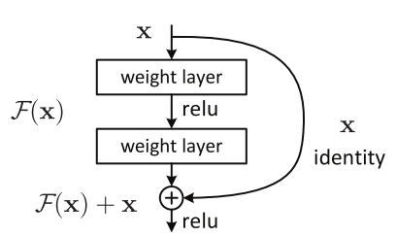
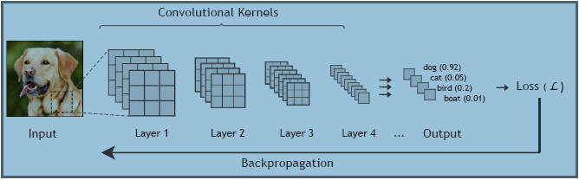
Introduction to rcnn
The Residual Convolutional Neural Network (RCNN) emerges as a novel approach to image denoising, leveraging deep learning techniques to achieve superior noise reduction performance.
RCNN addresses the limitations of traditional denoising methods by employing advanced neural network architectures and optimization algorithms to deliver clearer, more visually appealing images with reduced noise levels.
RCNN utilizes residual learning and skip connections to overcome challenges like gradient vanishing and explosion during training.
The network architecture is designed to learn the residual information directly, leading to improved denoising performance compared to conventional methods.
Figure 2: Schematic view of a convolutional neural network for an image classification task
Figure 3: Residual Block

Slide 6
Literature review
Traditional Approaches:
Techniques like Gaussian smoothing, median filtering, and Wiener filtering have been widely used for denoising. These methods are based on mathematical models and heuristics to remove noise from images.
Example:
Gaussian smoothing applies a convolution kernel to the image to blur out noise. However, it can lead to loss of image details. Wiener filtering aims to minimize the mean square error between the estimated and original image but requires knowledge of noise statistics. [3], [4], [6].
Deep Learning Approaches:
Recent advancements in deep learning have led to the development of convolutional neural networks (CNNs) specifically designed for image denoising. Methods like DnCNN (Deep Convolutional Neural Network) and RCNN (Residual Convolutional Neural Network) have demonstrated significant improvements in denoising performance.
Example:
DnCNN uses a deep CNN architecture with residual learning to directly learn the mapping between noisy and clean images. RCNN, introduced in this study, extends the concept of residual learning with skip connections to enhance denoising performance. [9], [10].

Slide 7
OBJECTIVE
Challenges in image denoising:
Noise Removal: Existing denoising methods often struggle to effectively remove noise while preserving important image details.
Kernel Estimation: Accurately estimating the noise distribution and characteristics poses a significant challenge for traditional denoising techniques.
Limitations of current methods:
Traditional Methods: Conventional denoising techniques such as median filtering or Gaussian blurring may result in loss of image sharpness or detail.
Deep Learning Approaches: While deep learning-based methods have shown promise, they may suffer from issues like overfitting or lack of generalization to diverse noise types and levels.
Justification for Exploring RCNN:
Overcoming Conventional Constraints: RCNN offers a novel approach by leveraging deep neural networks with residual learning and skip connections to address the limitations of traditional denoising methods.
Potential for Improved Performance: The inherent architecture of RCNN enables it to learn complex noise patterns and enhance denoising performance, making it a promising solution for overcoming existing challenges in image denoising.

Slide 8
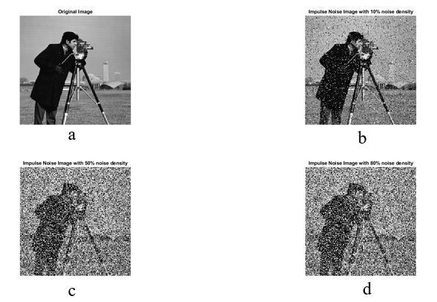
Need for advanced denoising techniques
Increasing Demand for High-Quality Images:
Images play a crucial role in decision-making across various fields.
Noise in images can hinder accurate analysis and interpretation.
Limitations of Existing Methods:
Traditional techniques often blur important details along with noise.
Advanced methods require precise noise characterization, limiting their applicability.
There's a need for techniques that can effectively remove noise while preserving image features.
Role of Advanced Denoising Techniques:
Deep learning-based approaches offer promising solutions by learning complex noise patterns.
They can distinguish noise from actual features, leading to more accurate denoising. These techniques leverage large datasets and computational resources for superior performance.
Figure 4: (a) Cameraman Image of size 256 x 256
(b) Salt and pepper noise image (10% noise density)
(c) Salt and pepper noise image (50% noise density)
(d) Salt and pepper noise image (80% noise density)

Slide 9
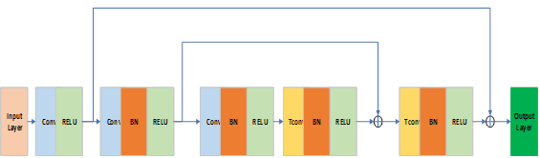
Proposed method
Introduction to RCNN architecture:
Utilizes residual learning and skip connections to address challenges in deep network training.
A three-stage architecture consisting of convolutional layers, batch normalization, and transpose convolution layers.
Components of RCNN:
Residual learning: Helps in mitigating the vanishing gradient problem, enabling training of deeper networks.
Skip connections: Allow for the reuse of earlier layer activations, facilitating better gradient flow and training efficiency.
Figure 6: : Proposed RCNN architecture for Image deconvolution

Slide 10
Results and discussion
Simulation Results:
Demonstrated the effectiveness of RCNN through simulation results.
Trained the RCNN network with a dataset of 400 images from the Berkeley Segmentation Dataset (BSD) for 30 epochs using Adam's optimizer and tested with the set of 12 standard images.
Comparative Analysis:
Compared denoising performance with existing methods such as deconvolution.
Highlighted the superior performance of RCNN in terms of PSNR and SSIM values.
Figure 7: Data Set of 12 images

Slide 11
Results and discussion contd
Figure 8: RMSE and LOSS curve of training

Slide 12
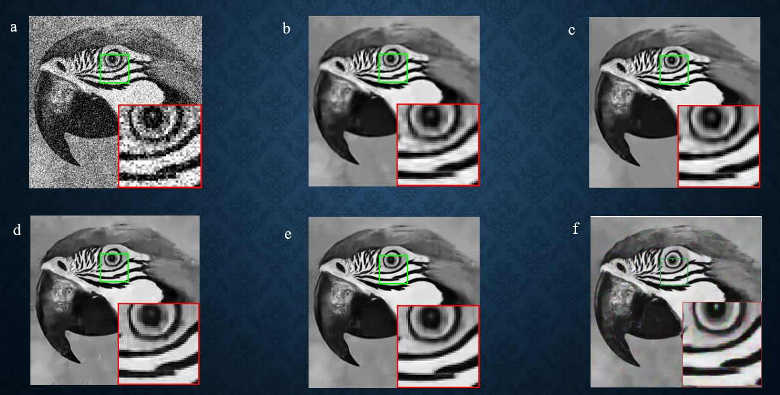
results and discussion
Visualization of Denoising Results:
Presented denoising results using sample images to illustrate the effectiveness of RCNN.
Showcased visually clear images obtained after denoising with RCNN compared to noisy input images
Figure 9: a - Noisy Parrot Image with 50% noise, b - PSNR: 25.8 dB ^{[10]}, c - PSNR: 26.1 dB ^{[11]},
d - PSNR: 25.9 dB ^{[12]}, e - PSNR: 26.4 dB ^{[13]}, f - PSNR: 27.2 dB ^{Proposed}

Slide 13



results
Table 1: PSNR comparison of DnCNN and RCNN for the data set of 12 images
Image | PSNR DnCNN (dB) | PSNR Proposed (dB) | SSIM DnCNN (dB) | SSIM Proposed (dB)
1 | 20.43 | 22.76 | 0.89 | 0.88
2 | 21.63 | 23.41 | 0.87 | 0.89
3 | 21.00 | 23.04 | 0.84 | 0.86
4 | 20.79 | 22.80 | 0.91 | 0.92
5 | 21.28 | 23.34 | 0.88 | 0.85
6 | 21.01 | 23.00 | 0.86 | 0.91
7 | 21.09 | 27.20 | 0.87 | 0.92
8 | 21.78 | 23.34 | 0.85 | 0.84
9 | 20.46 | 22.24 | 0.92 | 0.91
10 | 21.00 | 23.01 | 0.84 | 0.86
11 | 21.46 | 22.95 | 0.85 | 0.88
12 | 21.03 | 22.88 | 0.86 | 0.90
Avg | 21.08 | 22.96 | 0.87 | 0.89
$$MSE=\frac{1}{MN}\sum_{n=0}^{M}{\sum_{m=1}^{N}{{\left[\hat{g}\left(n, m\right)−g(n, m)\right]}^{2}}}$$
$\text{PSNR}\text{ = }\text{1}\text{0 }\text{log}\text{(255^2/}\text{MSE}\text{)}$
$SSIM\left(x,y\right)=\frac{(2μ_{x}μ_{y}+c_{1})(2σ_{xy}+c_{2})}{(μ_{x}^{2}+μ_{y}^{2}+c_{1})(σ_{x}^{2}+σ_{y}^{2}+c_{2})}$

Slide 14
conclusion
Key Findings Recap:
Emphasized the effectiveness of RCNN in image denoising based on the study's findings.
Highlighted the significant improvement in denoising performance achieved with RCNN compared to existing methods.
Summary of Conclusions:
Proposed RCNN demonstrated superior performance in image denoising compared to traditional and deep learning based methods.
Concluded that RCNN, with its innovative architecture and training approach, offers a promising solution for challenging denoising tasks.
Future Research Directions:
Suggested exploring RCNN in other image processing tasks or datasets to further validate its effectiveness and versatility.
Highlighted potential applications of RCNN beyond denoising, indicating its potential in various domains such as medical imaging, surveillance, and remote sensing.

Slide 15
references
Jin Z, Iqbal, M Z, Bobkov, D. Zou, We, Li, X_ and Steinbach, E. 2019. A flexible deep CNN framework for image restoration. IEEE Transactions on Multimedia, 22(4), pp_ 1055-1068.
Sravani R., Srinivas K., Raj. B P.: Removal of Low-Density Impulse Noise from Grayscale Images Using New Modified Hybrid Median Filter with Various Sliding Window Sizes. 2018 3rd IEEE International Conference on Recent Trends in Electronics, Information & Communication Technology (RTEICT), Bangalore, India. 1750-1754 (2018).
Kittler J., "On the accuracy of the Sobel edge detector," Image and Vision Computing, vol. 1, no. 1, pp. 37-42, 1983. xiv, xv, 55, 57, 58
Canny J., "A computational approach to edge detection," IEEE Transactions on pattern analysis and machine intelligence, pp. 679—698, 1986. xiv, 55, 61, 62, 90
Sankar M.R., Krishna P.R., Yamini A., Manikanta C., Swathika R.R., Tulasi Y.T, Raju B.E.: Optimization of Single Image Dehazing Based on Stationary Wavelet Transform. In International Conference on Cognitive Computing and Cyber-Physical Systems, 414-421 (2023).
Topological structural analysis of digitized binary images by border following," Computer vision, graphics, and image processing, vol. 30, no. 1, pp. 32—46, 1985. xiv, 55
Feng Y., Yang Y., Fan X., Zhang Z., Zhang J.: A Multiscale Generalized Shrinkage Threshold Network for Image Blind Deblurring in Remote Sensing. IEEE Transactions on Geoscience and Remote Sensing, 62, 1-16 (2024)
Cho G., Choi Y.S.: Image Super-Resolution with Unified-Window Attention. IEEE Access, 12, 30852-30866 (2024).

Slide 16
References
G. Liu, F. A. Reda, K. J. Shih, T.-C. Wang, A. Tao, and B. Catanzaro, "Image inpainting for irregular holes using partial convolutions," in European Conference on Computer Vision (ECCV), September 2018. x, xvi, 3, 74, 89, 97, 99, 102, 103, 104, 105, 108, 122
M. S. M. Sajjadi, B. Scholkopf, and M. Hirsch, "Enhancement: Single image super-resolution through automated texture synthesis," in The IEEE International Conference on Computer Vision (ICCV), IEEE, 2017. xi, 35, 74, 91, 95, 122, 125, 128
Gu S., Zhang L., Zuo W., Feng X.: Weighted nuclear norm minimization with application to image denoising. In Proceedings of the IEEE conference on computer vision and pattern recognition, 2862-2869 (2014).
Zoran D., Weiss Y.: November. From learning models of natural image patches to whole image restoration. In 2011 international conference on computer vision, 479-486, IEEE (2011).
Levin A., Nadler B., Durand F., Freeman W.T.: Patch complexity, finite pixel correlations and optimal denoising. In Computer Vision–ECCV 2012: 12th European Conference on Computer Vision, Florence, Italy, October 7-13, Proceedings, 73-86, Springer Berlin Heidelberg (2012).
Kumar G.P., Priya G.S., Dileep M., Raju B.E., Shaik A.R., Sarman, K.V.S.H.G.: Image Deconvolution using Deep Learning-based Adam Optimizer. In 2022 6th International Conference on Electronics, Communication and Aerospace Technology, 901-904, IEEE (2022)
Kumar G.P., Arputharaj J.V., Kumar P.R., Kumar D.V., Satyanarayana B.V.V., Budumuru P.R.: A Comprehensive Review on Image Restoration Methods due to Salt and Pepper Noise. In 2023 2nd International Conference on Automation, Computing and Renewable Systems (ICACRS), 562-567 IEEE (2023)
Padmavathy N., Naidu N.S., and Harshitha V.: A Fusion of Histogram Equalization Technique and Fuzzy Logic for Sustained Enhancement of images. International Conference on Smart and Sustainable Energy Systems (ICSSES 2024). IEEE (In Press), (2024)

Slide 17
Thank You

